Slide 1

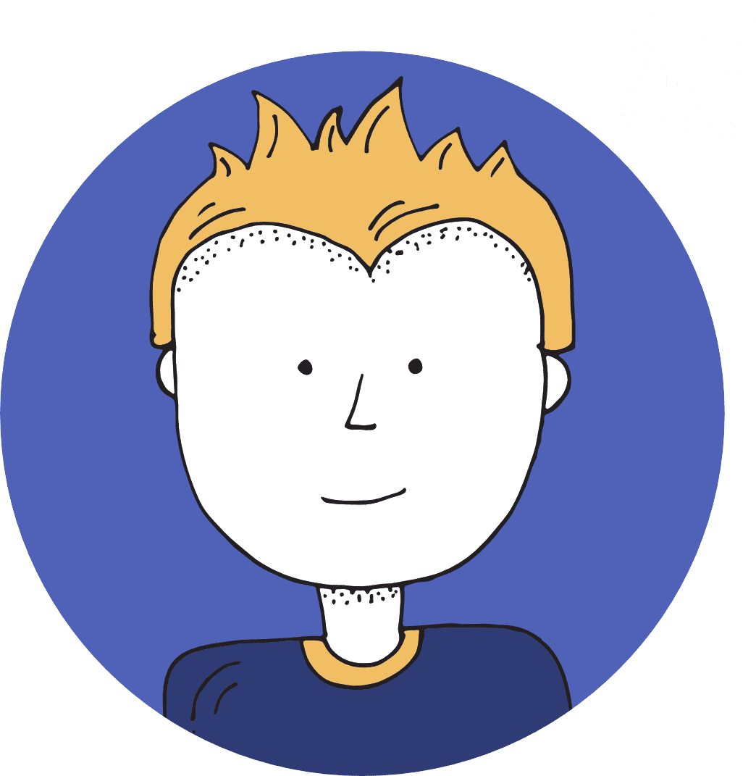

Slide 2
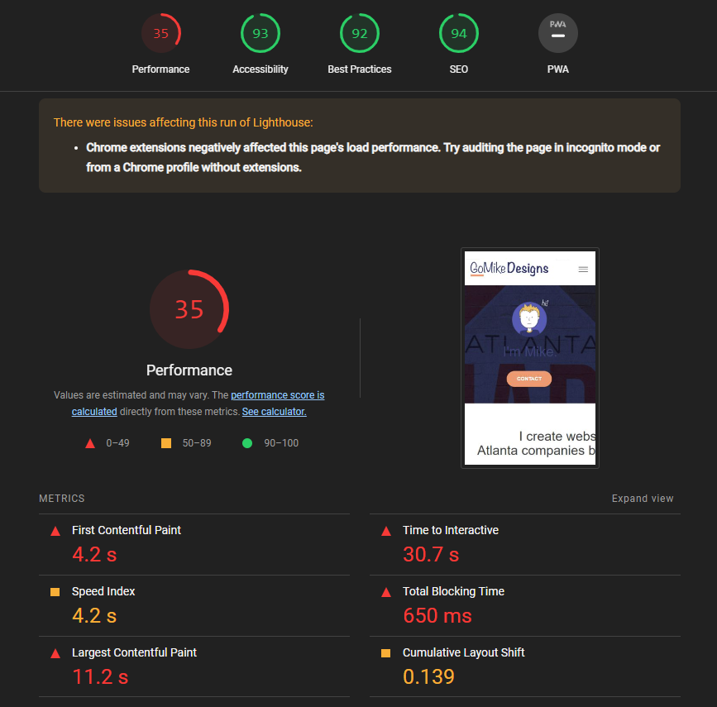
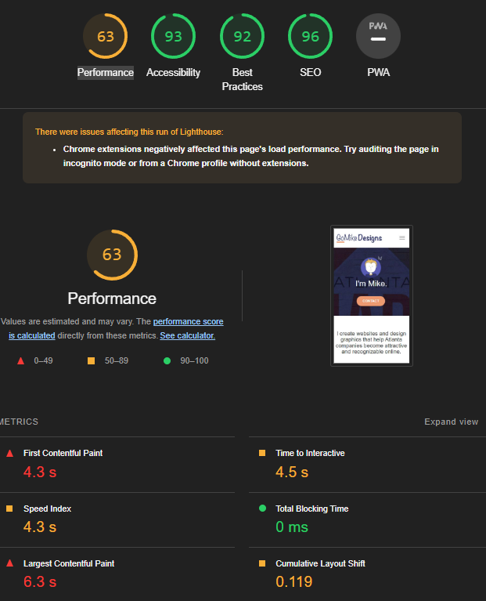
Before
After

Slide 3
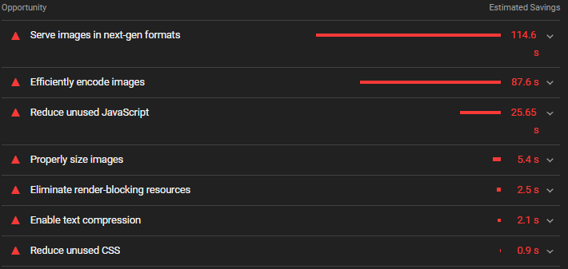
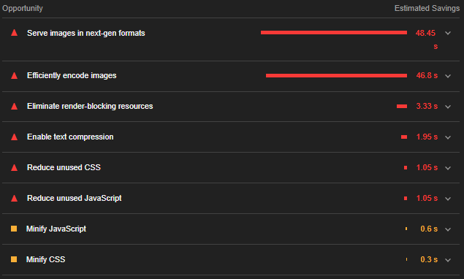
Before
After

Slide 4
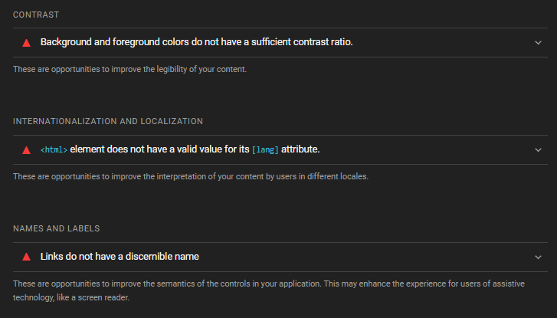
Fixed Contrast/Language/Semantics

Slide 5
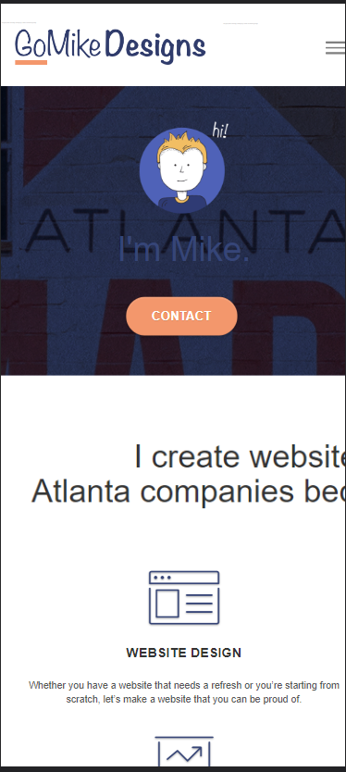
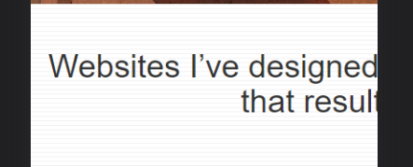
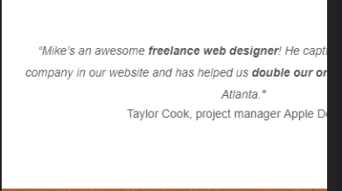
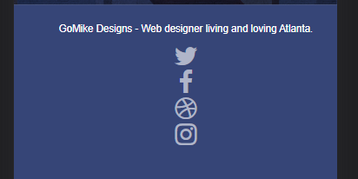
Before

Slide 6
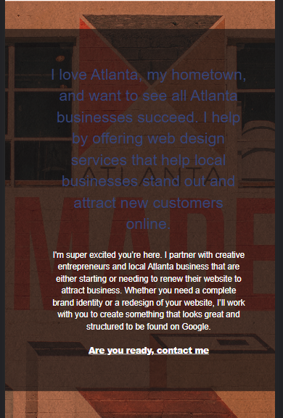
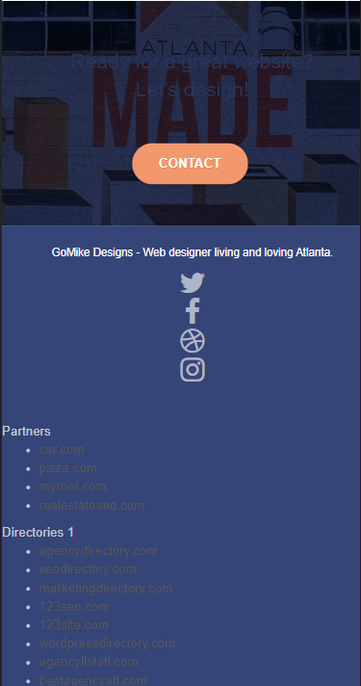
Before

Slide 7
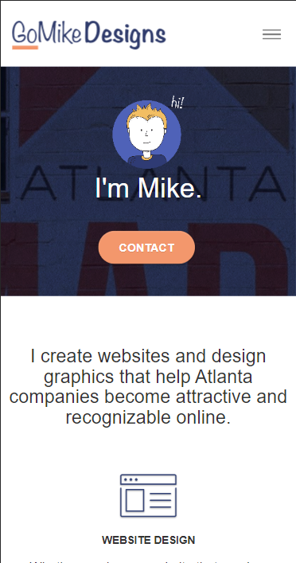
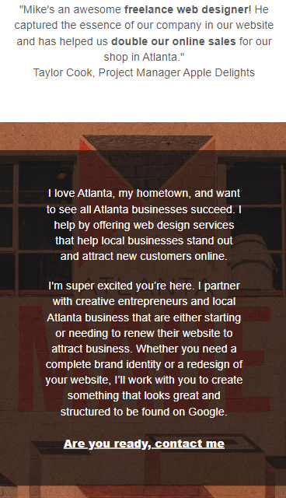
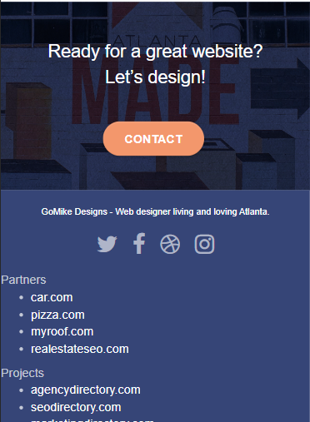
After

Slide 8
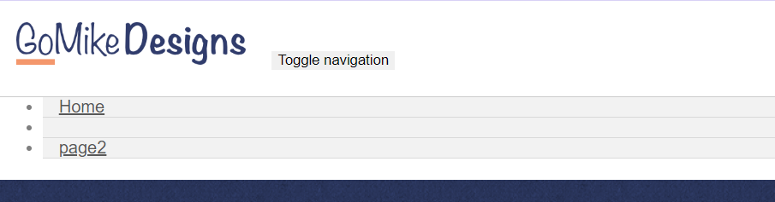

Navigator Menu - Contact page
Before
After

Slide 9
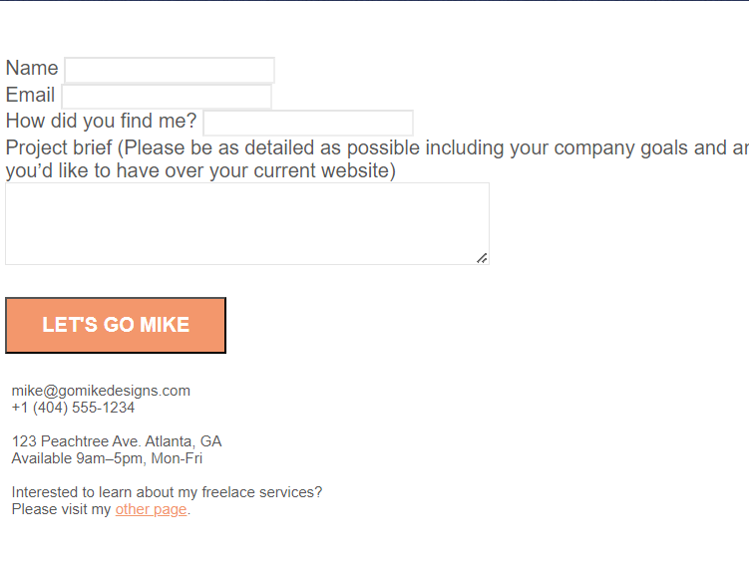
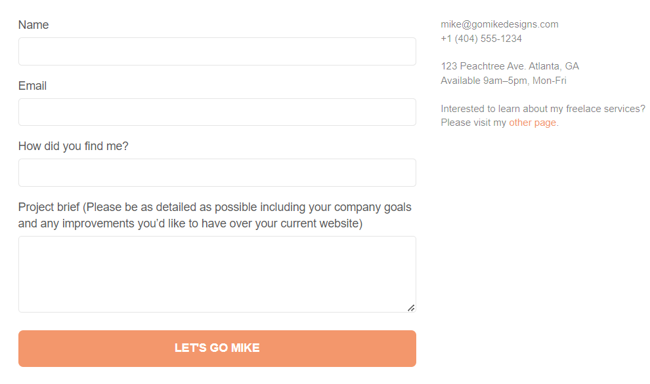
Contact form
Before
After

Slide 10
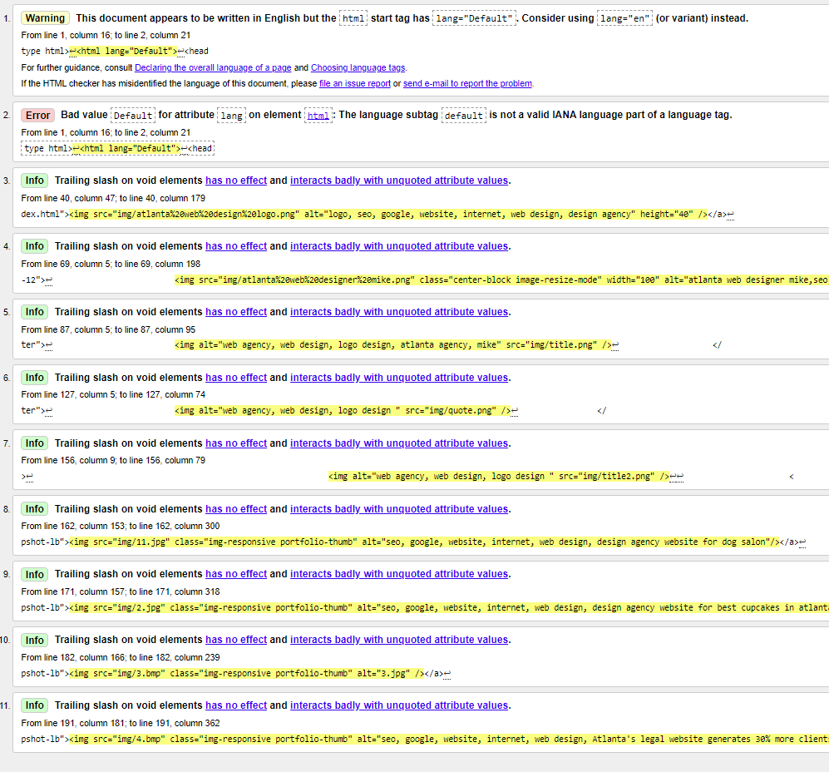
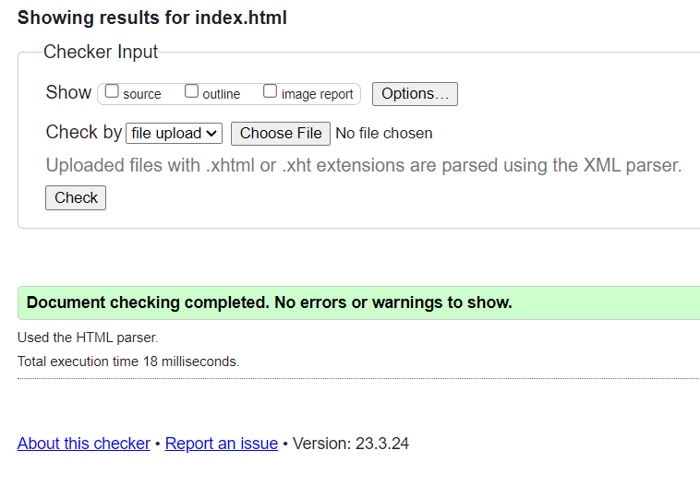
HTML Validator - Index
Before
After

Slide 11
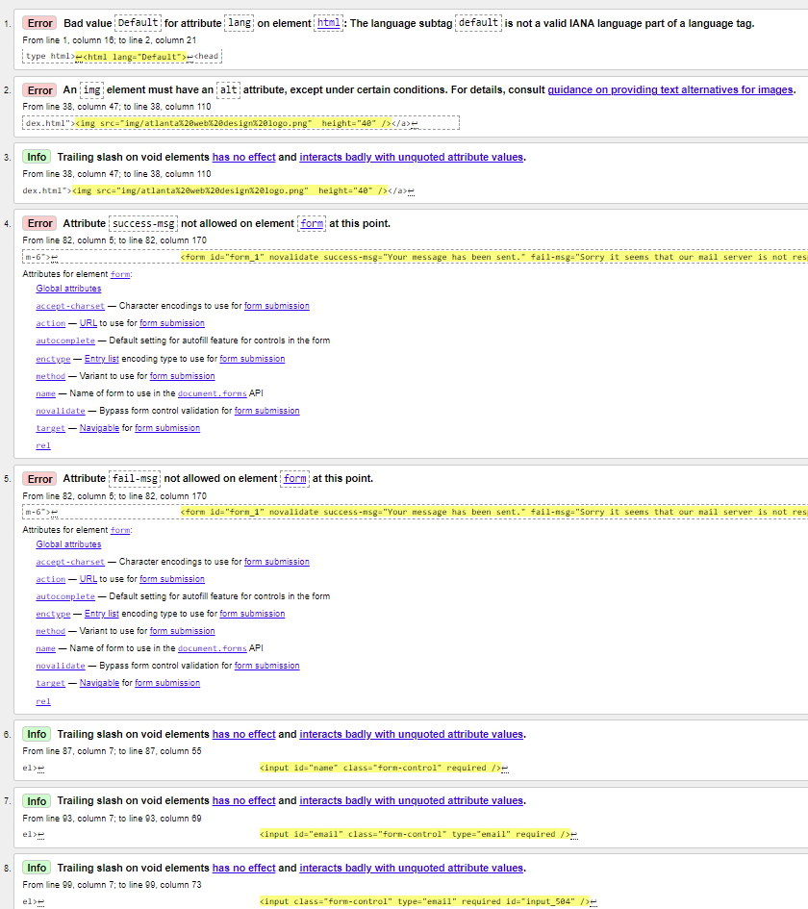
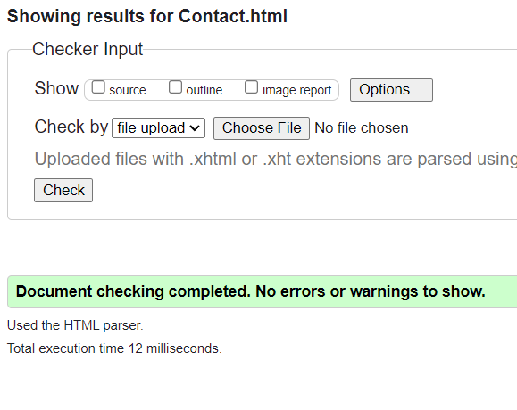
HTML Validator - Contact page
Before
After

Slide 12
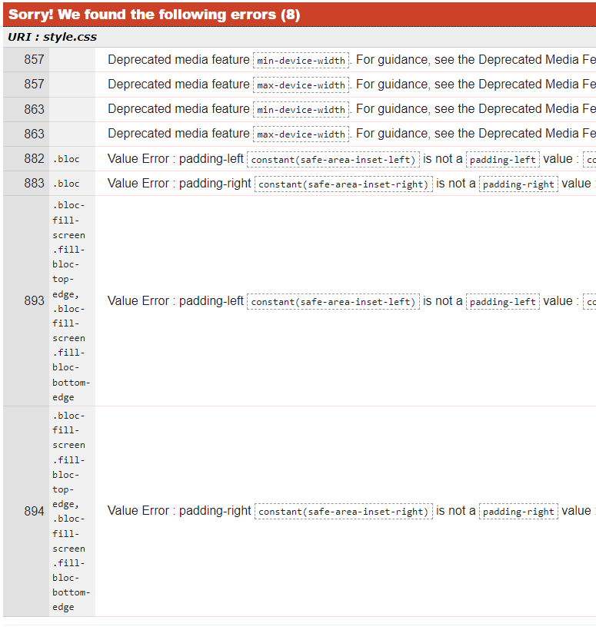
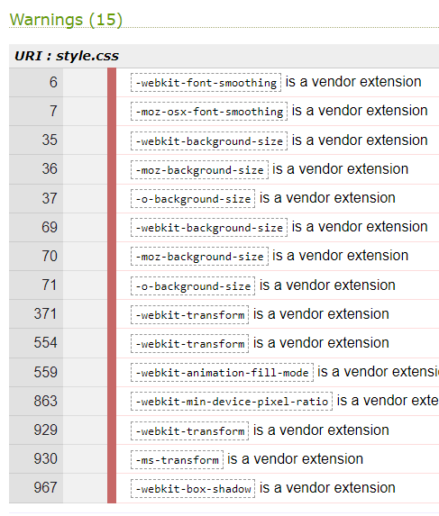
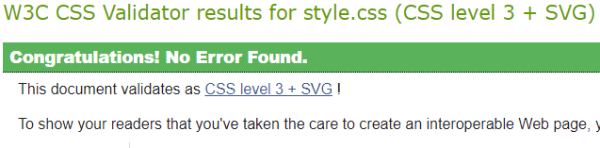
CSS Validator - Contact page
Before
After

Slide 13
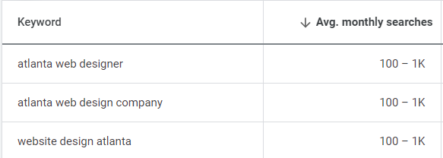
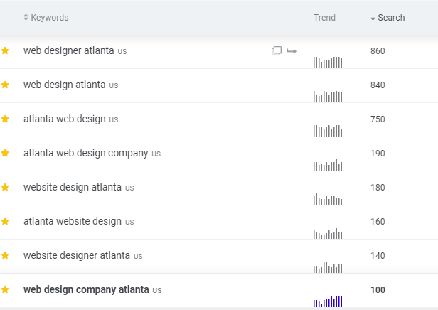
Keywords
Keywords used | Avg. Monthly search
atlanta web designer | 100 – 1000
atlanta web design company | 100 – 1000
website design atlanta | 100 – 1000
web designer atlanta | 100 – 1000
atlanta web design company | 100 – 300
website design atlanta | 100 – 300
atlanta website design | 100 – 300
website designer atlanta | 100 – 300
web design company atlanta | 100 – 300
https://ads.google.com/aw/keywordplanner
https://app.mangools.com/kwfinder/

Slide 14
Before
Image description
After
alt="atlanta web designer mike,seo, google, website, internet, web design, design agency"
alt="seo, google, website, internet, web design, design agency website for dog salon"
alt="seo, google, website, internet, web design, design agency website for best cupcakes in atlanta"
alt="3.jpg"
alt="seo, google, website, internet, web design, Atlanta's legal website generates 30% more clients after web redesign"
alt="logo, seo, google, website, internet, web design, design agency"
alt="atlanta web designer mike,seo, google, website, internet, web design, design agency"
alt="Logo Atlanta web designer - Go Mike"
alt="Banner Atlanta web designer - Go Mike">
alt="Picture with Atlanta's Premiere dog salon"
alt="Picture with a web redesign project for the best Atlanta cupcakes"
alt="Picture with web services for Atlanta's best tech gear shop"
alt="Picture with web services for a website that generates 30% more clients after web redesign in Atlanta"

